Slide 1
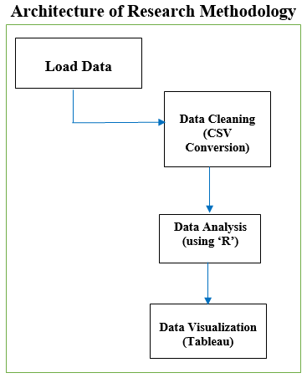
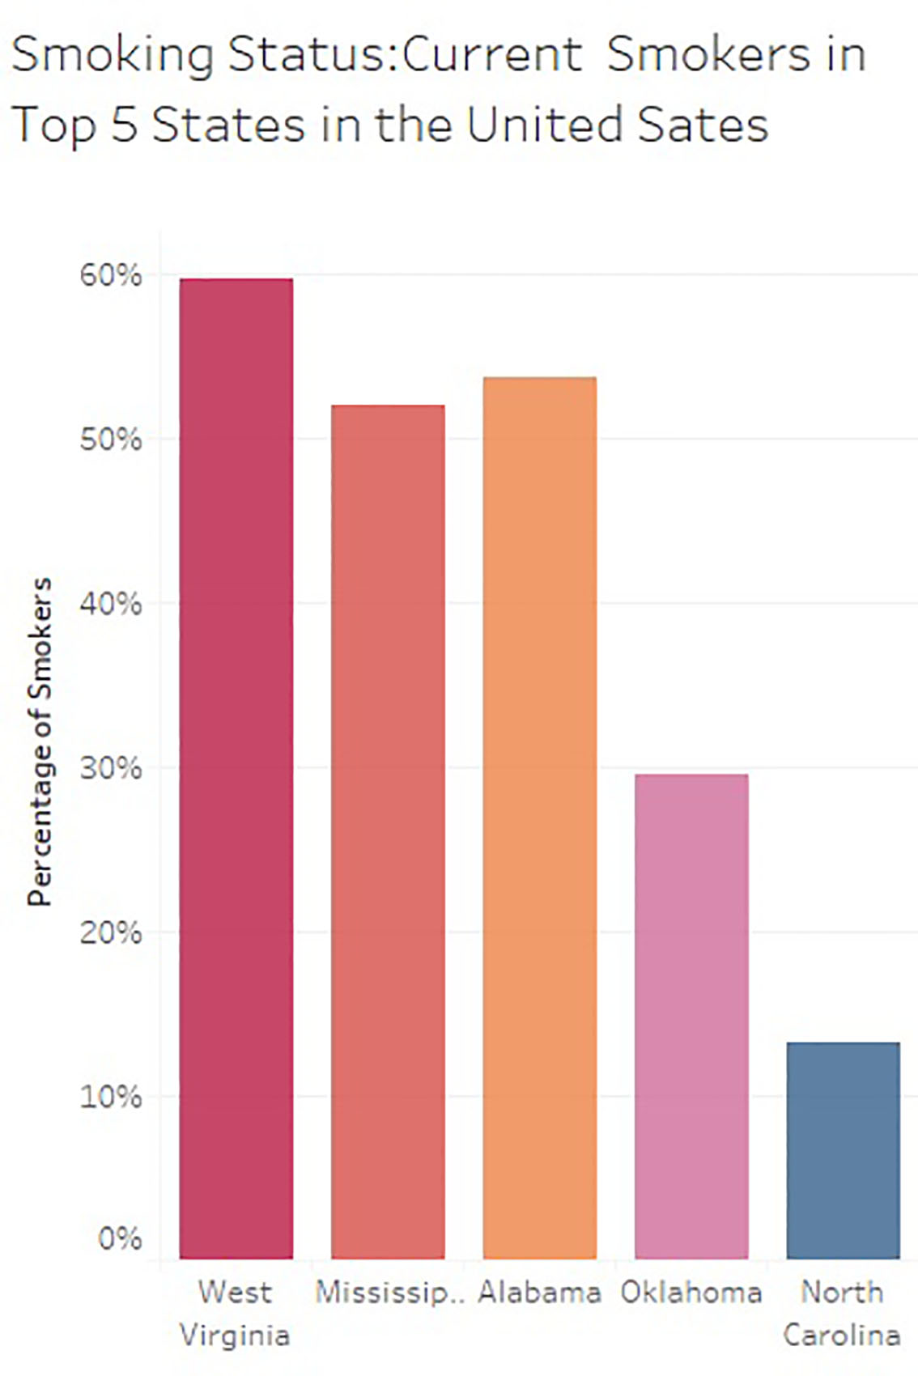
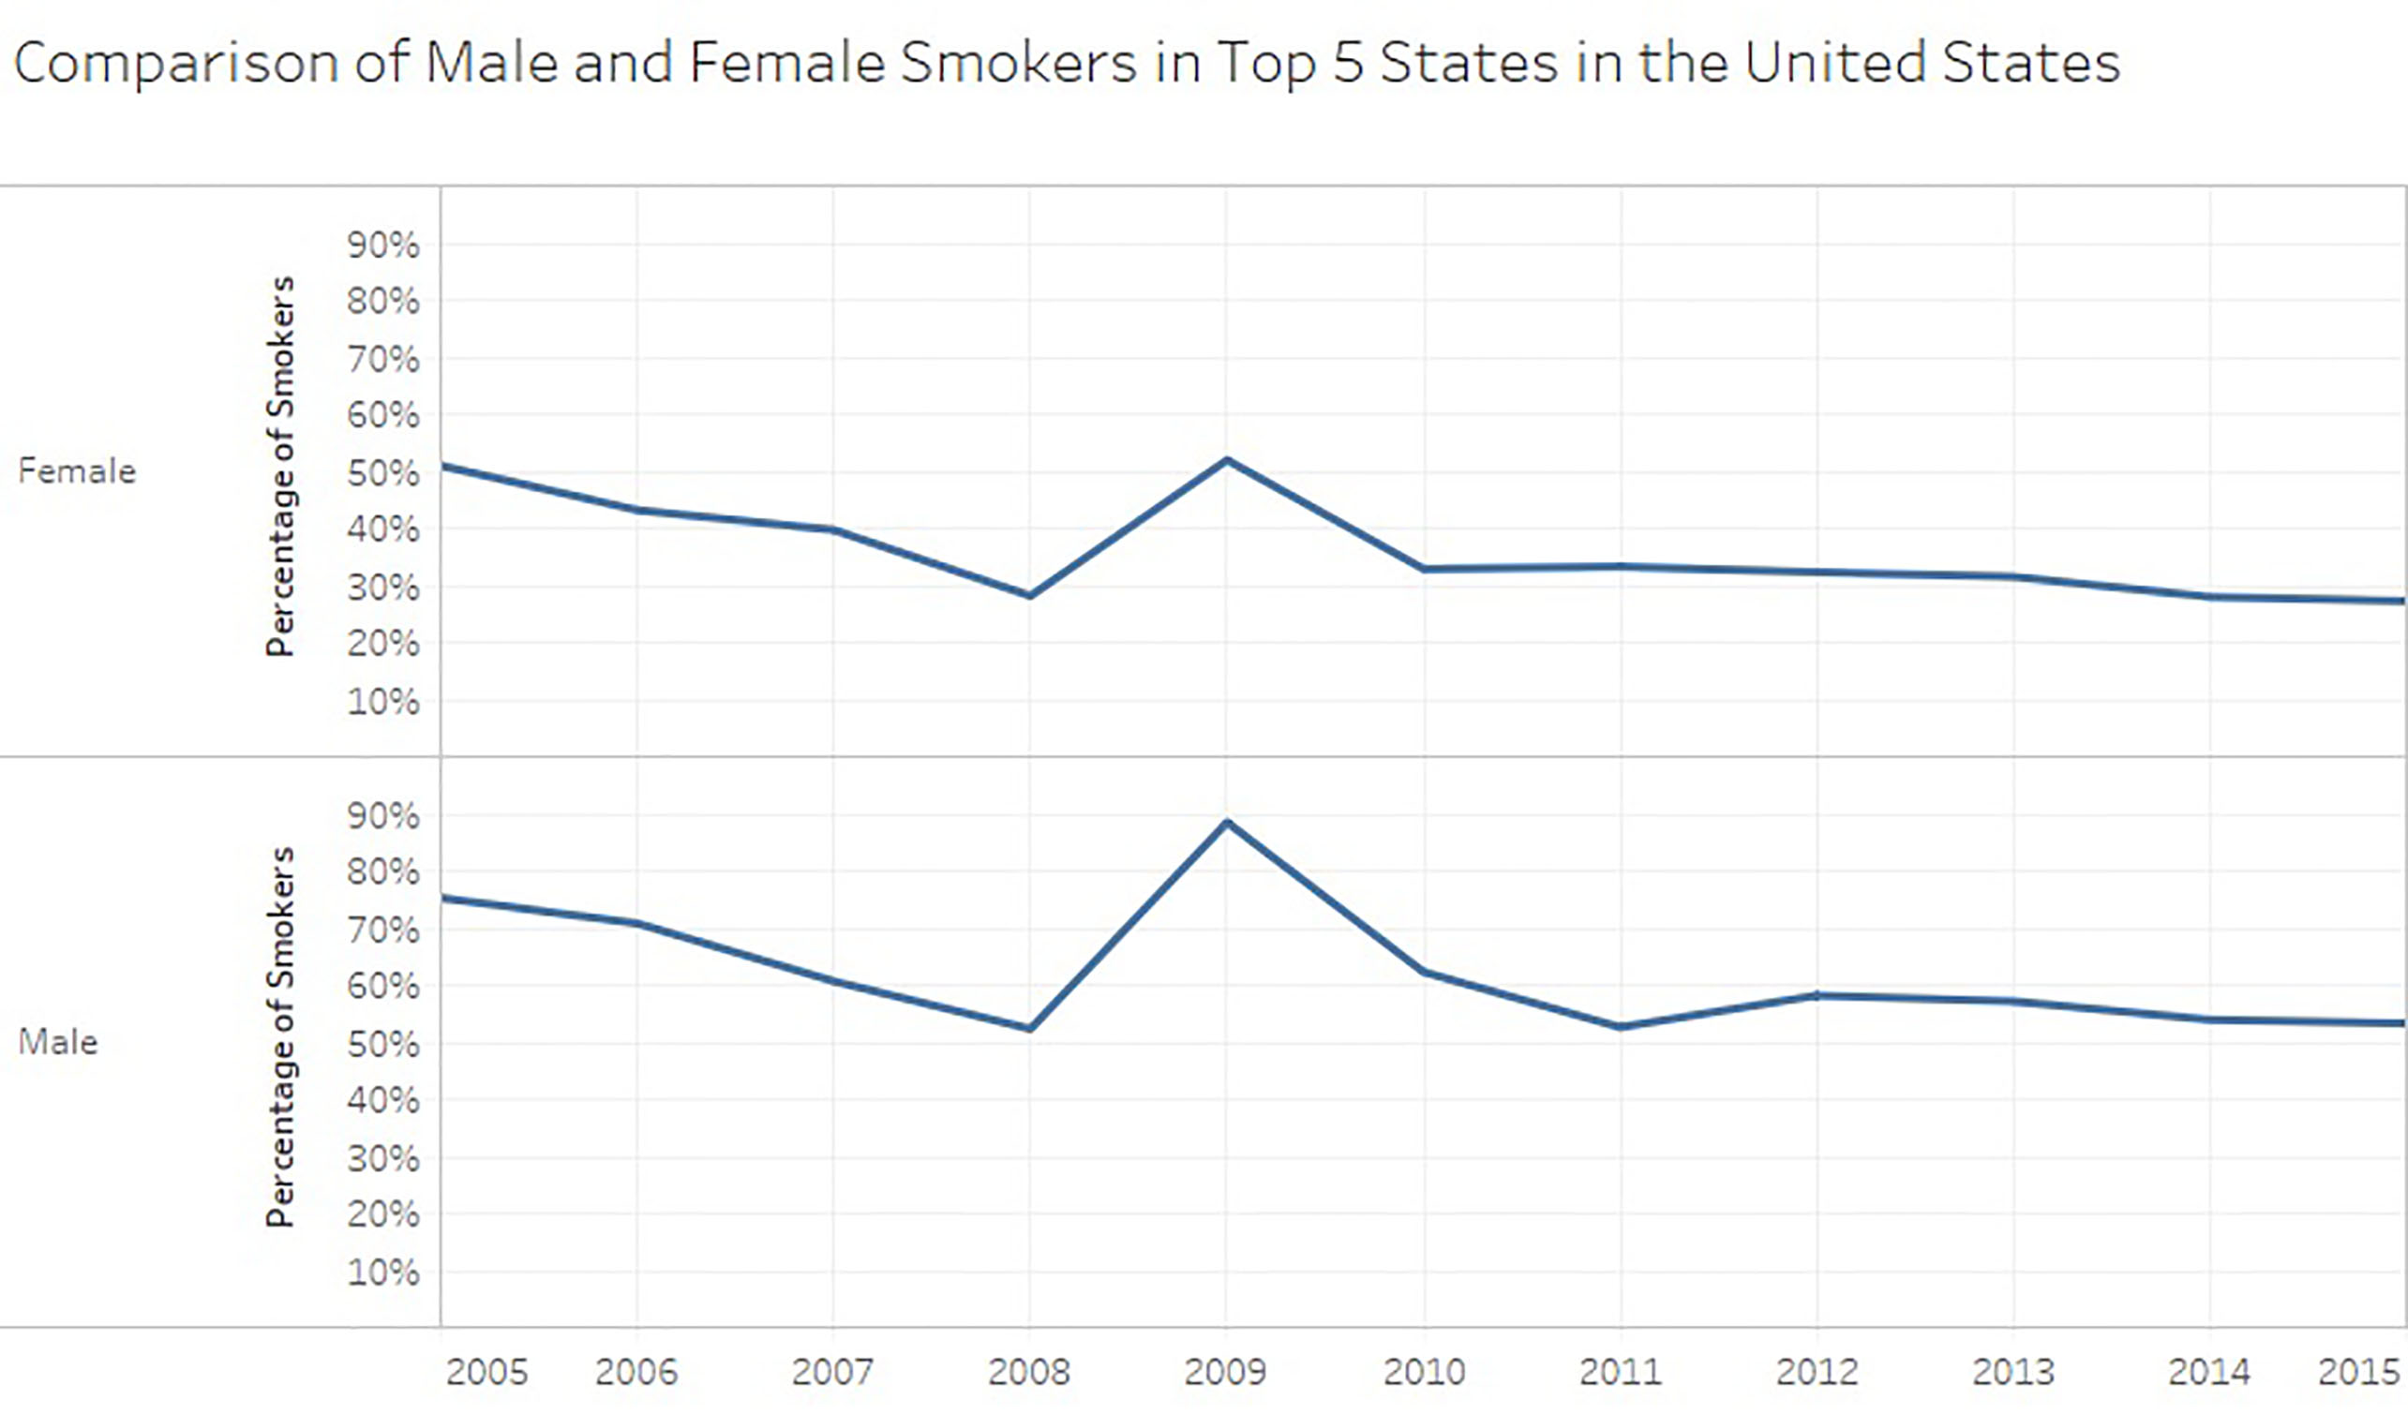
Big Data Analysis of Youth Tobacco Smoking Trends in the United States Shilpa Balan, Nishant Shristiraj, Vrunda Shah, Anusha Manjappa 2017 IEEE International Conference on Big Data, Boston, MA
INTRODUCTION
The healthcare industry has generated large amounts of data [5]. Cigarette smoking is a leading risk factor for morbidity in the United States [3]. Cigarette smoking has a significant effect on the health of Americans, and is a major cause of cardiovascular disease [2]. Big data in healthcare is now being used to predict epidemics, cure diseases, and avoid preventable deaths. The main aim of this research is to analyze the tobacco smoking trends using big data analytic techniques among the youth in the United States. This research also aims to increase the awareness of the impacts of tobacco smoking.
BACKGROUND
Cigarette smoking is the leading cause of preventable disease and death in the United States [6]. According to the 2012 NSDUH survey [4], the prevalence of current cigarette smoking among the youth 12–17 years of age was 6.6% and was similar among youth males (6.8%) and youth females (6.3%) [4]. In this research, the current tobacco smoking trends among the youth in the United States are analyzed.
METHODOLOGY
The dataset considered is an open dataset published by the Centers for Disease Control and Prevention [1]. Seventeen years of data from 1999-2016 was considered. The data was organized in a CSV format and cleaned. The data contains information on smoking status, cessation, and cigarette use among the youth. In this research, Tableau and R are used to analyze the smoking trends in United States. R is an open source programming language used for analyzing data using statistical methods and The data visualizations were further enhanced using a data visualization software named Tableau.
RESULTS
West Virginia ranks the highest for the number of current youth tobacco smokers in the United States. The top five states with the highest number of youth tobacco smokers in the United States are West Virginia, Mississippi, Alabama, Oklahoma, and North Carolina. From 2009, there has been a decline in the overall number of male and female youth tobacco smokers. It is found that the number of youth male smokers is slightly higher than the female smokers. Our analysis also showed that more than 51% of current youth tobacco smokers in the United States want to quit smoking.
CONCLUSION
The results in this study stresses for researchers to come up with initiatives which will drive the youth in the United States to quit or decrease their rate of smoking for a healthier life. Future research can be carried out on health impacts of tobacco smoking.
REFERENCES
[1] Centers for Disease Control and Prevention (2017). Youth Tobacco Survey (YTS) Data. Retrieved on April, 2, 2017, from https://catalog.data.gov/dataset/youth-tobacco-survey-yts-data [2] Holbrook, JH., Grundy, SM., Hennekens, CH., Kannel, WB., Strong, JP. (1984). Cigarette smoking and cardiovascular diseases: A statement for health professionals by a task force appointed by the steering committee of the American Heart Association. [3] Murray, CL, Abraham, J, et al (2013). The state of US health, 1990-2010: Burden of diseases, injuries, and risk factors. US Burden of Disease Collaborators, JAMA, 310:591–608. [4] NSDUH (2012). Prevalence of current smokeless tobacco use among adults 18 years of age and older, by selected characteristics. National Survey on Drug Use and Health. [5] Raghupathi, W. (2010). Data Mining in Health Care. In Healthcare Informatics: Improving Efficiency and Productivity. Edited by Kudyba S. Taylor & Francis. p211–223. [6] U.S. Department of Health and Human Services (2014). The Health Consequences of Smoking—50 Years of Progress: A Report of the Surgeon General. Atlanta: U.S. Department of Health and Human Services, Centers for Disease Control and Prevention, National Center for Chronic Disease Prevention and Health Promotion, Office on Smoking and Health.

